Slide 1
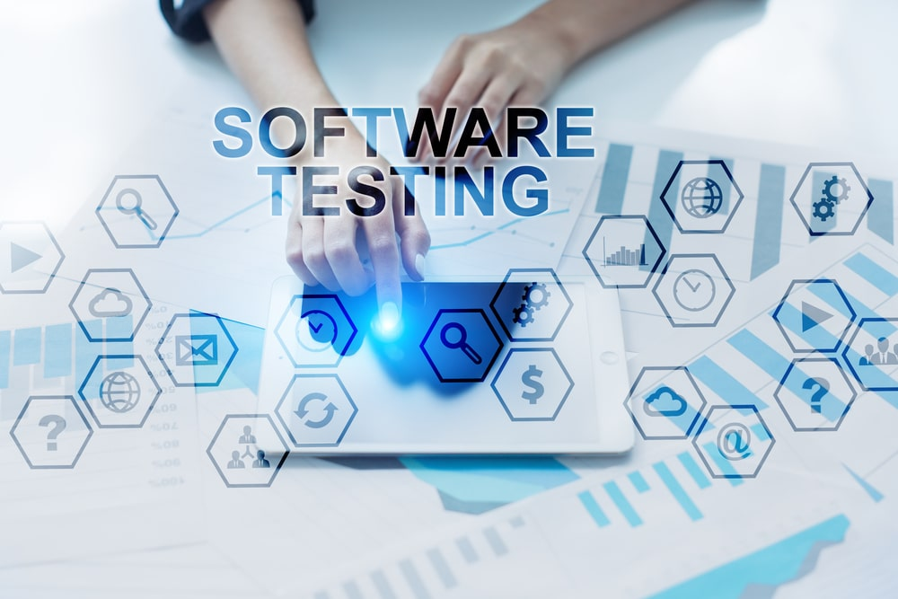
By Sravani

Slide 2
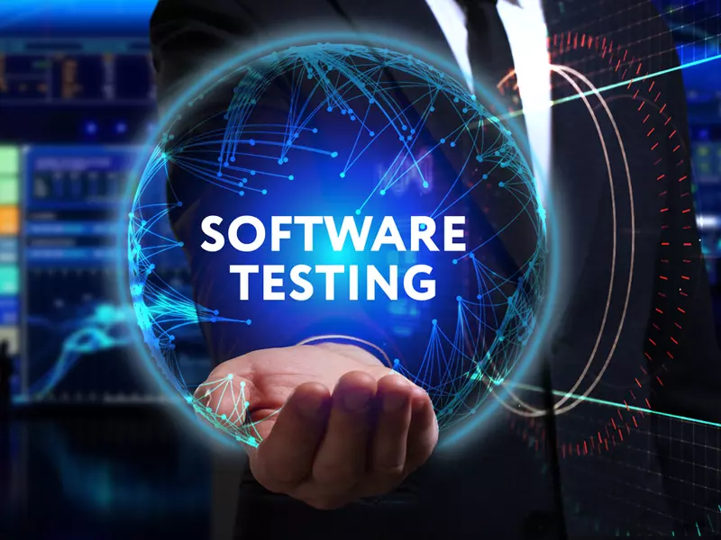
contents
Economics of Testing
How Testing is conducted
Software Testing(then)
Software Testing (now)
Scope of software testing
Factors influencing the Scope of Testing
Risk based Testing
Project Risks
Product risks
Need of Independent Testing
Activities in Fundamental Test process
Attributes of a good tester
Psychology of testing
Code of Ethics for testing
Limitations of Software Testing

Slide 3
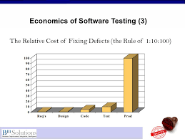
Economics of Testing
There is a definite economic impact of software testing. One economic impact is from the cost of defects. This is a very real and very tangible cost. Another economic impact is from the way we perform testing. It is possible to have very good motivations and testing goals while testing in a very inefficient way.

Slide 4
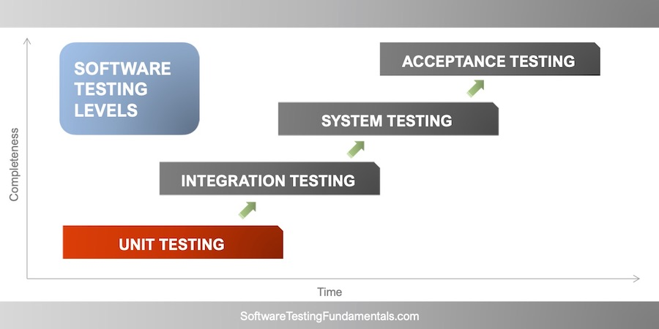
How Testing Is Conducted?
5 key software testing steps every engineer should perform
Basic functionality testing. Begin by making sure that every button on every screen works.
Code review. Another pair of eyes looking at the source code can uncover a lot of problems.
Static code analysis.
Unit testing.
Single-user performance testing.
Testing is based on external expectations - Internal behavior of the application is unknown.
Testing is done based on high-level database diagrams and data flow diagrams.
Internal workings are fully known, and the tester can design test data accordingly.

Slide 5

Software Testing Then(Past)
Testing was done by team according to the people choice
Lack of technology
There are less professions for testing due to lack of technical knowledge
Testing was learned by less people
All testers were expected to know programming languages and understand the working principles of operating systems.

Slide 6

Software Testing Now (present)
Technology was improved
Each tester has technical knowledge
Testing was done separately by each person in a team
Testing was not done in a huge way

Slide 7
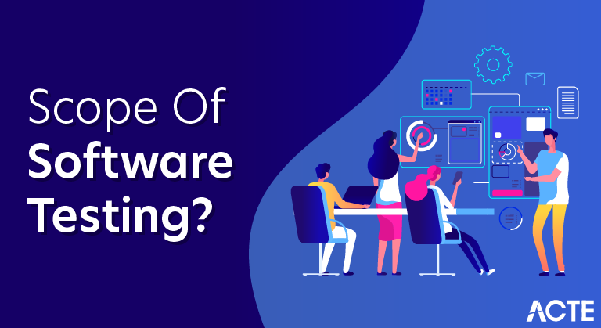
Scope Of Software testing
The Scope Of Software Testing:
Technically, Software Testing is an investigation conducted to provide stakeholders with information about the quality of a particular product or service under test.
In other words, software testing is a process of verification and validation.

Slide 8
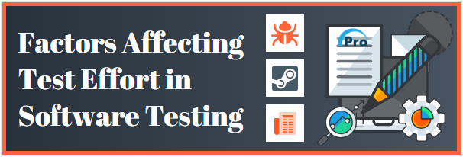
Factors influencing the Scope of Testing
Documentation: Maintaining good documentation with detailed information overall adds advantage to software development project. ...
Software Application Size: ...
Software Life Cycle: ...
Process Maturity: ...
Time: ...
Skilled Team: ...
Team and Work Relationship: ...
Test Results:

Slide 9
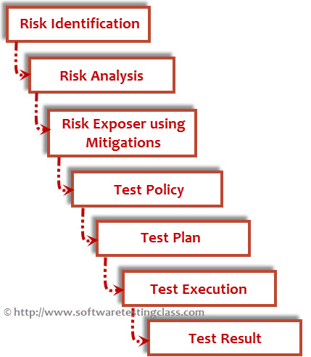
Risk Based Testing
Risk Based Testing (RBT) is a software testing type which is based on the probability of risk. It involves assessing the risk based on software complexity, criticality of business, frequency of use, possible areas with Defect etc. Risk based testing prioritizes testing of features and functions of the software application which are more impactful and likely to have defects.
Risks can be positive or negative.
Positive risks are referred to as opportunities and help in business sustainability. For example, investing in a New project, Changing business processes, Developing new products.
Negative Risks are referred to as threats and recommendations to minimize or eliminate them must be implemented for project success.

Slide 10
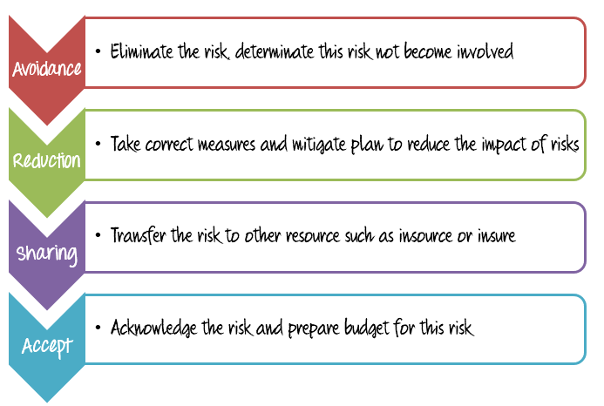
project Risks
Testing is an activity like the rest of the project and thus it is subject to risks that cause danger to the project.
The project risk that can endanger the project are Risk such as the late delivery of the test items to the test team or availability issues with the test environment.
Project risk is the potential of a project to fail.
There are three main types of project risks:
cost,
schedule,
performance.

Slide 11
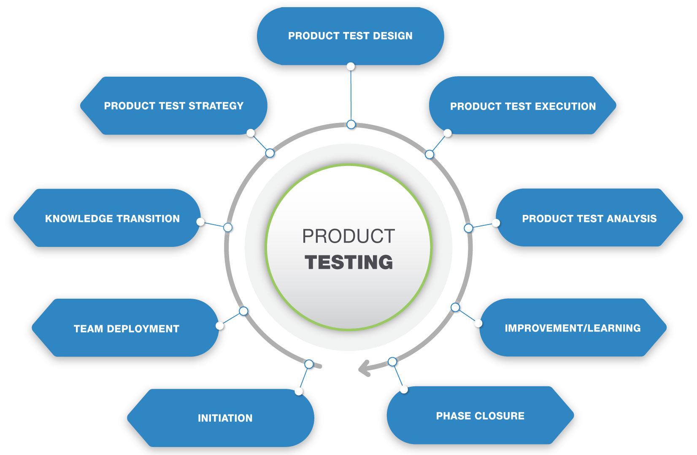
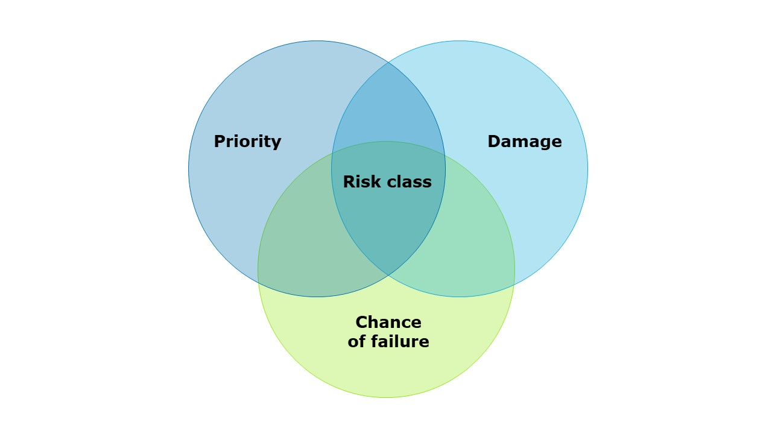
Product Risks
Product risks result from problems with the delivered product.
Product Risks associate with specific quality characteristics of the product.
Therefore, they are also known as Quality Risks.
These characteristics are :
Functionality as per client requirements
Reliability of software
Performance Efficiency
Usability
Security of software
Compatibility
Ease of Maintenance
Portability

Slide 12
Need of independent testing
Independent testing has an upper hand over traditional testing in many ways. Let’s look at some of the key advantages that it offers:
1.Improved Software Quality – One of the top benefits of outsourcing testing to independent testing organizations is improved software quality. Independent testing teams engage in a bias-free procedure and make sure that the product is developed according to customer requirements and meets the desired objectives while maintaining high quality.
2.Experienced and Skilled Manpower – Independent testing organizations have experienced and skilled manpower to carry out testing activities in the best possible manner. They hire the best of talent across various testing domains like automation testing, manual testing, load testing, security testing, etc.
3. Lower Life Cycle Costs – Organizations that employ independent testers can focus exclusively on quality and adherence to requirements and maintainability and scalability to address future needs. This ensures low failure rates and reduced maintenance costs. Rigorous testing cycles for both functional and non-functional aspects like performance and stress handling is covered.

Slide 13
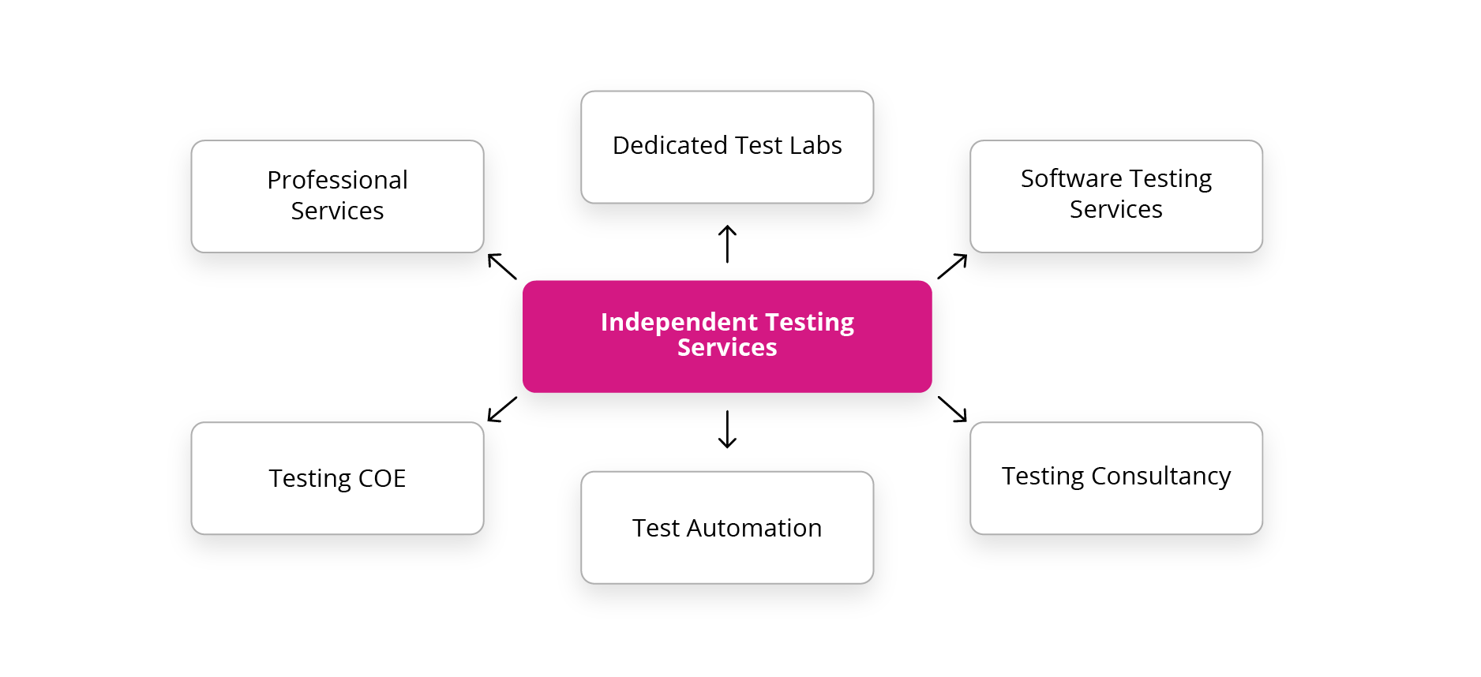
4. Reduced Time to Market – There is a reduced and improved time to market for organizations having an independent testing practice. Access to expertise in test automation skills ensures faster testing cycles. Predictability to testing efforts ensures adherence to timelines. Optimized staffing ensures effective handling of dynamic requirements.
5. Flexibility – We are living in a fast-paced world, and we need to be flexible in order to keep up with the pace. You can opt for automation testing or manual testing based on organizational needs. You can easily switch between manual and automation testing as independent testing organizations have the best of talent and expertise to do so.

Slide 14
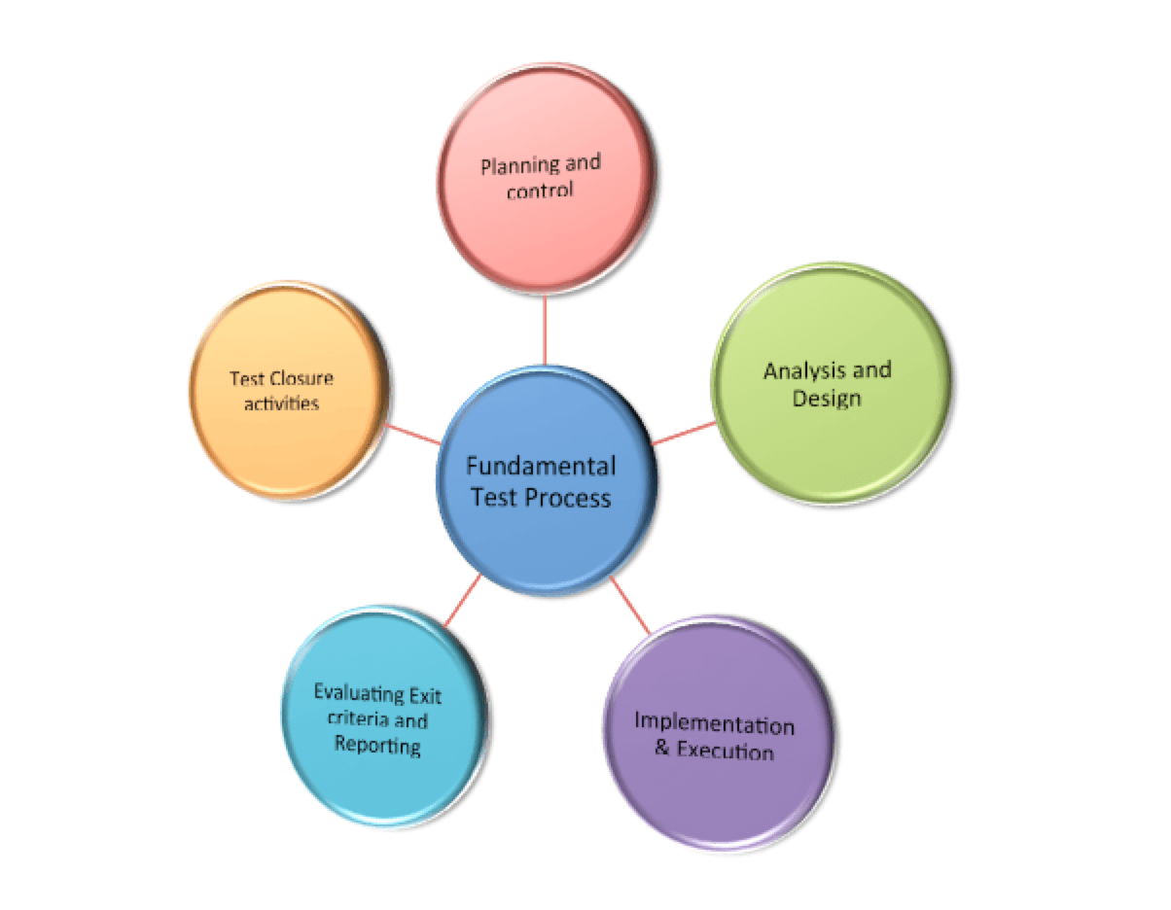
Activities of Fundamental Test process
Fundamental Test Process
Test Planning and Control.
Test Analysis and Design.
Test Implementation and Execution.
Evaluating Exit Criteria and Reporting.
Test Closure.

Slide 15
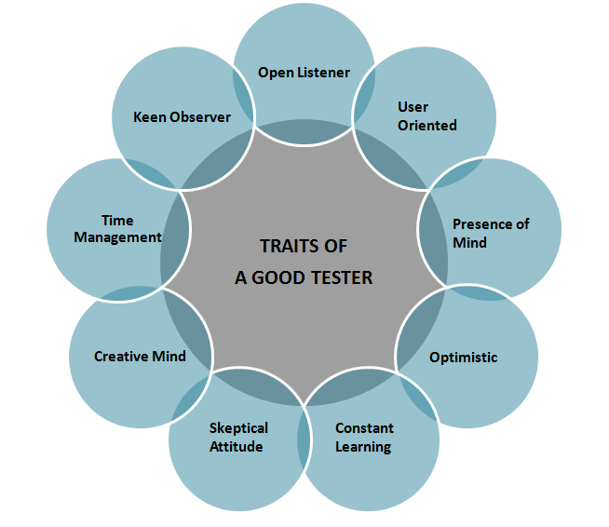
Attributes of a Good Tester
1.Positive Attitude. A positive attitude is a key agent to succeed in any field and Software Testing is not an exception.
2.Good Communication. It helps to overcome critical problems easily. You can understand problems easily, document better and convince effectively.
3.Multi-Tasking Abilities. Multi-tasking abilities are the demand of today’s era. Work on multiple projects and provide updates.
4.Quick Learner. A great tester is a quick and self-learner. You do not HAVE to learn new stuff; you should WANT to learn it.
5.Passion For Testing. You have got to love your job. A passion for delivering quality, for providing better user experience, for generating new ideas, etc. is critical.
6.Team Player. Being a team player is a must for every job, but it takes on a whole new dimension because we have to deliver bad news.

Slide 16

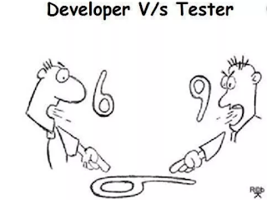
Psychology of Testing
The Mindset of Developers and Testers. Before we start the discussion on this topic, it is important to note that developers also do the testing of the system.
Polite and Clear Communication. As discussed earlier, testers find mistakes or errors in the system and communicate these findings with the developers.
Test Independence.

Slide 17
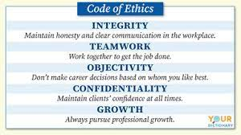
Code of ethics for tester
For the first case, the Code of Ethics says: “Software testers shall be fair to and supportive of their colleagues and promote cooperation with software developers.” On the other hand, it also has this: “Software testers shall maintain integrity and independence in their professional judgment.”

Slide 18
^{Software Testing Limitations}
We use testing to disclose many hidden errors, but this methodology never guarantees the absence of errors. It is only used to identify the known errors. ...
Testing do not provide you any help when you must decide either “you should release the product consisting errors for meeting the deadline” or “you should release ...
Software testing does not predict or estimate the proper functioning of the product under different conditions, but it may prove to be helpful in delivering the information w.r.t. ...
While injecting the defects, software testing unable to find the root causes which may help in placing defects at the first place. ...
Testing cannot be done against system requirements. We also cannot detect any errors in requirements or ambiguous requirement leads the complete testing process to inadequate testing.
*** End ***

